Slide 1

ACTIVITY PREDICTION OF THE ELDERLY
SRM INSTITUTE OF SCIENCE AND TECHNOLOGY
COLLEGE OF ENGINEERING AND TECHNOLOGY
DEPARTMENT OF NETWORKING AND COMMUNICATIONS
18CSP107L / 18CSP108L- MINOR PROJECT / INTERNSHIP
Student 1 Reg No: RA1911028010032
Student 2 Reg No: RA1911029010089
Batch ID: NWC032089
Guide name and Designation: Mrs. G. Parimala, Assistant Professor

Slide 2
TABLE OF CONTENTS
S.NO. | TITLE | SLIDE NO.
1. | INTRODUCTION | 3
2. | OBJECTIVES | 4
3. | ABSTRACT | 5
4. | LITERATURE SURVEY | 6
5. | BLOCK DIAGRAM | 8
6. | ARCHITECTURE DIAGRAM | 9
7. | UML DIAGRAMS | 11
8. | EXPERIMENT | 14
9. | ALGORITHMS USED | 15
10. | MODELS USED | 16
11. | MODULES | 17
12. | IMPLEMENTATION | 18
13. | REFERENCES | 25

Slide 3
INTRODUCTION
•This is a web based application for a smart healthcare monitoring system.
•This application is made for the elderly people living alone in developing countries to predict their activity through wristbands connected to mobile application which will monitor their activity status.
•This application employs Artificial Intelligence and Machine Learning techniques such as Decision Tree Classifiers and Logistic Regressors.

Slide 4
OBJECTIVES
The objective of the project is to gain the insight about the activities of the elderly and to predict their movements that could be useful to them and is easily assessable as well as operable.
Our project's objective is to gather information through wristbands connected to the mobile application that will determine how active a person is depending on the physical activities they engage in.
The application project uses a machine learning-based fall detector and multi-agent architecture for contacting emergency assistance.

Slide 5
ABSTRACT
Health care is very important for any human being. With modern time, the need of health care services for elderly people is increasing day by day. The family members of the elderly people have poor work-life balance and rising workloads create a necessity for improved and advanced technology. In many developing countries, senior citizens often live alone and are responsible for managing their own jobs. A product has to be created in order to assure the wellbeing of their physical and mental health using smart gadgets and developing technology. The service requires accurate predictions of their body health using sensors from their smartphones to measure their daily life activities. The product is a web application that tracks movements of the elderly using sensors and then monitors their actions using Artificial Intelligence and Machine Learning techniques such as Decision Tree Classifiers and Logistic Regressors. The project introduces a machine learning-based fall detector as well as a multi-agent architecture for contacting emergency assistance via an input sensor from the web-based monitoring application. Our product estimates to have an accuracy of 0.99 using Decision Tree whereas 0.69 was the accuracy of the model using ANN (taken from the base paper). Due to these techniques, accurate data can be calculated and verified.

Slide 6
LITERATURE SURVEY
Title | Year | Achievements | Limitations/Suggestions
Activities Recognition, Anomaly Detection and Next Activity Prediction Based on Neural Networks in Smart Homes | 2022 | The proposed approach consists of three stages which are activity recognition, anomaly detection and next activity prediction. Such a system can provide useful information for the elderly, caregivers and medical teams to identify activities and generate preventive and corrective measures. | A clean sequence of activities has been constructed by discarding the anomalous instances. Future work needed to handle the imbalance dataset to improve the deep learning models.
Jointly Prediction of Activities, Locations, and Starting Times for Isolated Elderly People | 2021 | This paper proposes a multi- task activity prediction system that jointly predicts labels, locations, and starting times of future activities. Uses body activity information from wearable sensors and motion information from passive environmental sensors to sense activities of daily living of older adults. | These systems can provide better services to assist older people if it anticipates what activities inhabitants will perform ahead of time.

Slide 7
Title | Year | Achievements | Limitations/Suggestions
Health status prediction for the elderly based on machine learning | 2020 | The machine learning methods help researchers select the predictors of health status in the older population efficiently. The artificial neural networks have the best prediction accuracy in relation to older people's self-reported health. | Researchers are challenged with developing advanced techniques to examine the datasets as well as identifying the appropriateness to build a predictive model
Fall Detection For elderly patients -DRT | 2019 | Chosen Random Classifier with parameters like max_depth as 50 and n_estimators as 200 along with a threshold of 0.4 To be the best model not only because of the highest accuracy scores but also because it has the lowest false negative rate. | The cost is comparatively low because the assumption is that companies prevalent already in the healthcare field will adopt this solution.

Slide 8
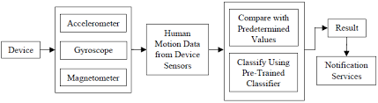
BLOCK diagram

Slide 9
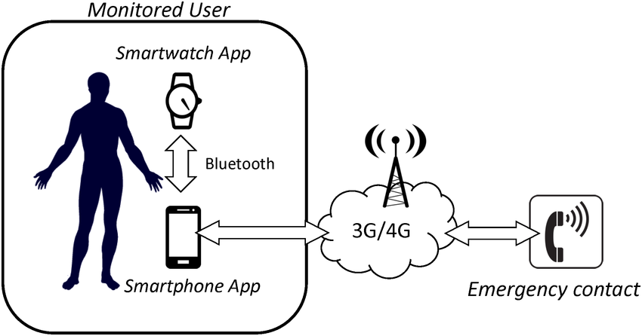
ARCHITECTURE diagram

Slide 10
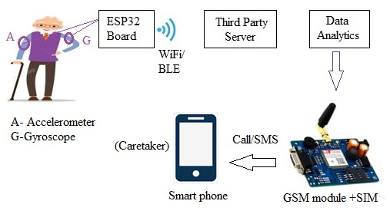

Slide 11
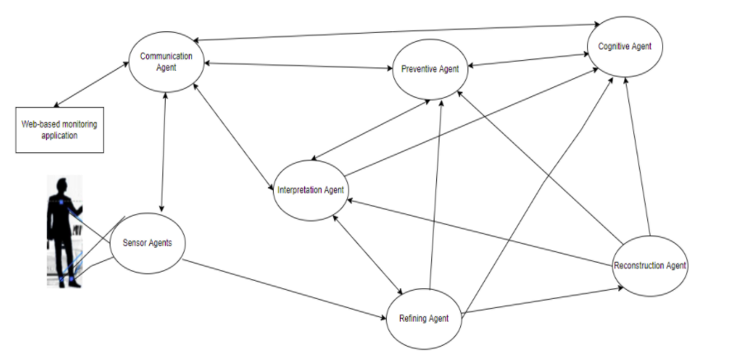
UML Diagrams MULTI AGENT ARCHITECTURE

Slide 12
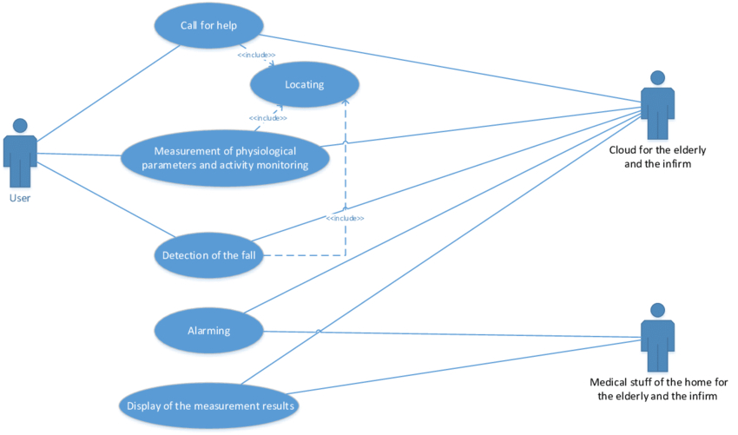
Use case diagram of the service for monitoring activities and location of users

Slide 13
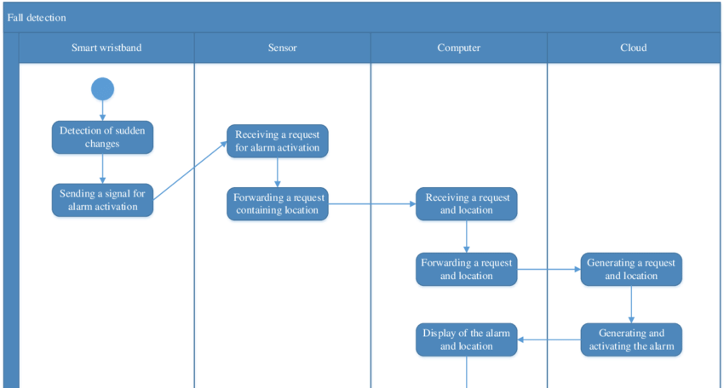
ACTIVITY DIAGRAM

Slide 14
EXPERIMENT
This experiment is mainly split up into the following sections: 1. Data Preview. Take the original data set, import it into the database, and observe its data structure. 2. Data Merge. In the original dataset, the questionnaire for each topic is separate. It makes sense to merge them into a single dataset to simplify the analysis. 3. Feature selection. Apply machine learning algorithms to extract the factors that have the greatest impact on the health of older adults. 4. Data processing. Process the data until you can use the data to train a machine learning model. 5. Training model. Train multiple machine learning models using the comparative training set. 6. 5-fold cross-validation. The entire data set is randomly divided into 5 groups, one group is called the validation set, the rest are called the training set, and the validation is run 5 times using different algorithms to test accuracy. 7. Result. Get results and further summarize conclusions.

Slide 15
ALGORITHMS USED
MODELLING: SKLEARN
Principal component analysis
Decision tree Classifier
Supervised Machine Learning where the data is continuously split according to a certain parameter.
Logistic Regression
Logistic regression is a statistical analysis method to predict a binary outcome, such as yes or no, based on prior observations of a data set.
Library provides a selection of efficient tools for machine learning and statistical modelling including classification, regression, clustering etc.
PCA is often used to simplify data, reduce noise, and find unmeasured “latent variables”.
K Neighbors Classifier
KNN is mostly used to classifies a data point based on how its neighbours are classified.

Slide 16
MODELS USED
matplotlib==3.4.1
Matplotlib is a comprehensive library for creating static, animated, and interactive visualizations in Python.
2. numpy==1.20.1
NumPy is a Python library used for working with arrays. It also has functions for working in domain of linear algebra, fourier transform, and matrices.
3. Pandas==1.3.2
Pandas is an open source Python package that is most widely used for data science/data analysis and machine learning tasks.
4. scikit_learn==1.0.2
Scikit-learn is probably the most useful library for machine learning in Python. The sklearn library contains a lot of efficient tools for machine learning and statistical modeling including classification, regression, clustering and dimensionality reduction.
5. streamlit==0.88.0
Streamlit is an open source app framework in Python language. It helps us create web apps for data science and machine learning in a short time.

Slide 17
MODULES
1. Data Cleaning
2. Exploratory Data Analysis
3. Modelling
4. Dimensionality Reduction using Principal Component Analysis (PCA)
5. Logistic Regression
6. Decision Tree Classifier

Slide 18
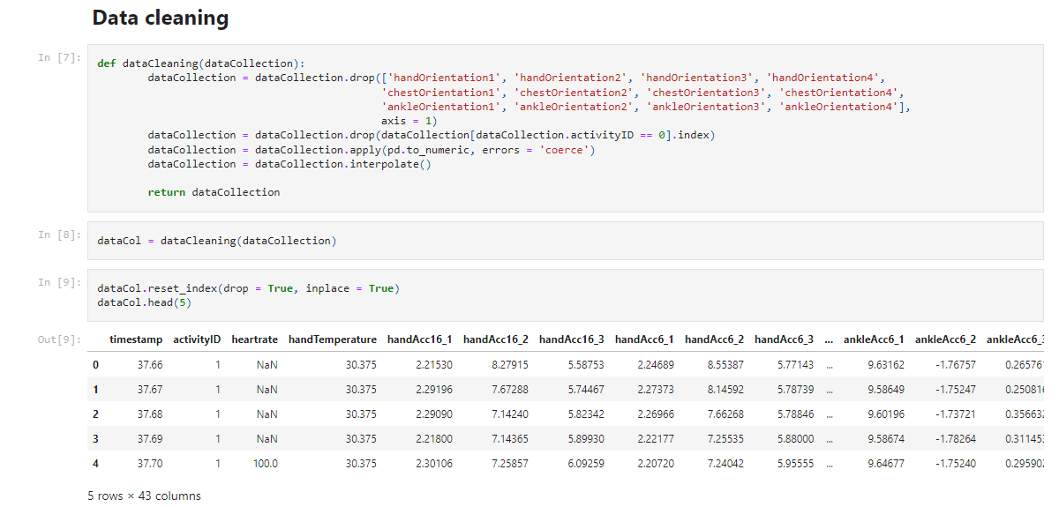
implementation

Slide 19
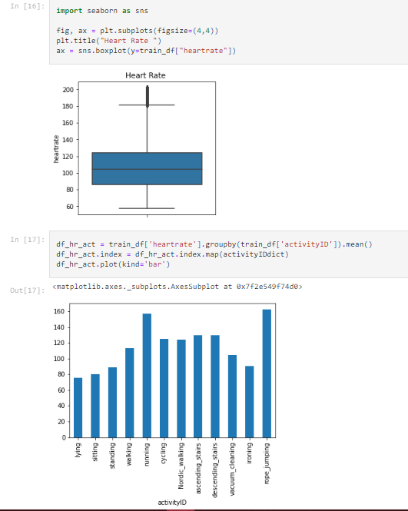
EXPLORATORY DATA ANALYSIS

Slide 20
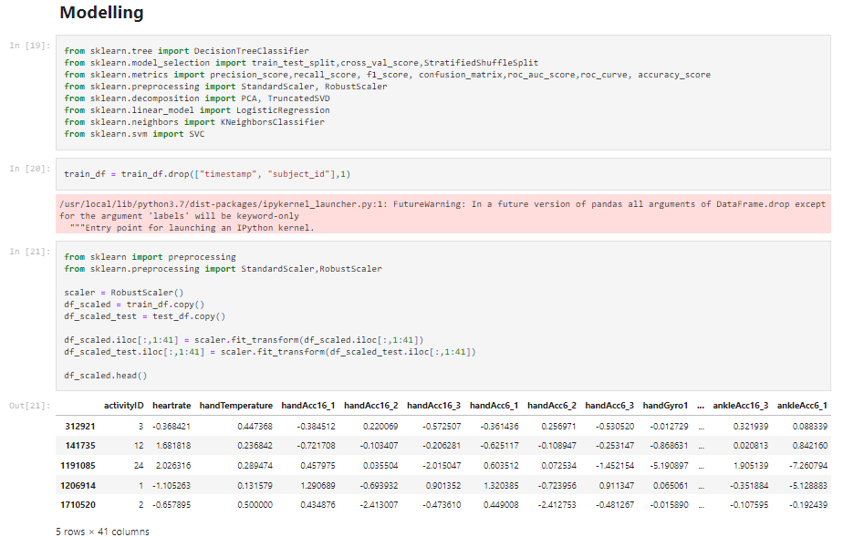

Slide 21
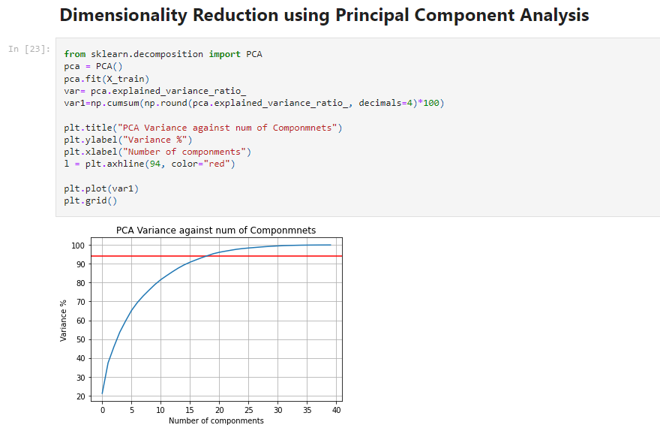

Slide 22
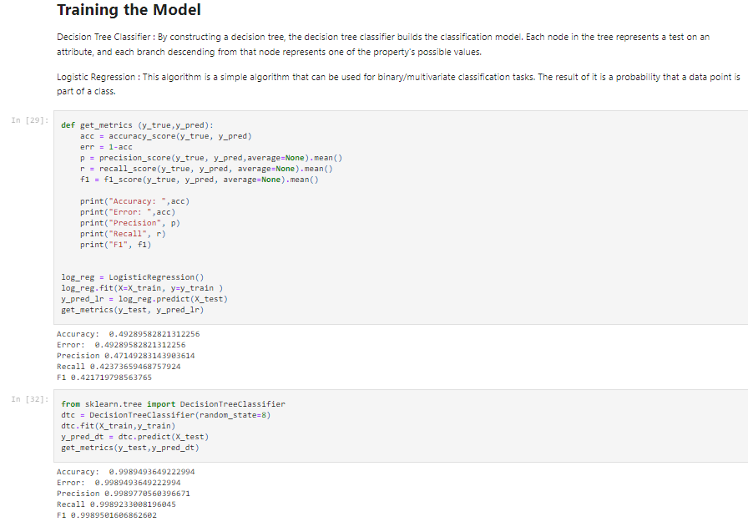
LOGISTIC REGRESSION

Slide 23
DECISION TREE CLASSIFIER

Slide 24
REFERENCES
https://www.researchgate.net/publication/341571722_Health_status_prediction_for_the_elderly_based_on_machine_learning
https://www.kaggle.com/code/drtina/fall-detection-for-elderlypatients-drt#Present-your-solution.
https://ieeexplore.ieee.org/document/9729817
https://ieeexplore.ieee.org/document/9580533/keywords#keywords
https://ieeexplore.ieee.org/search/searchresult.jsp?newsearch=true&queryText=activity%20prediction%20of%20the%20elderly

Slide 25
Thanks

